Slide 1
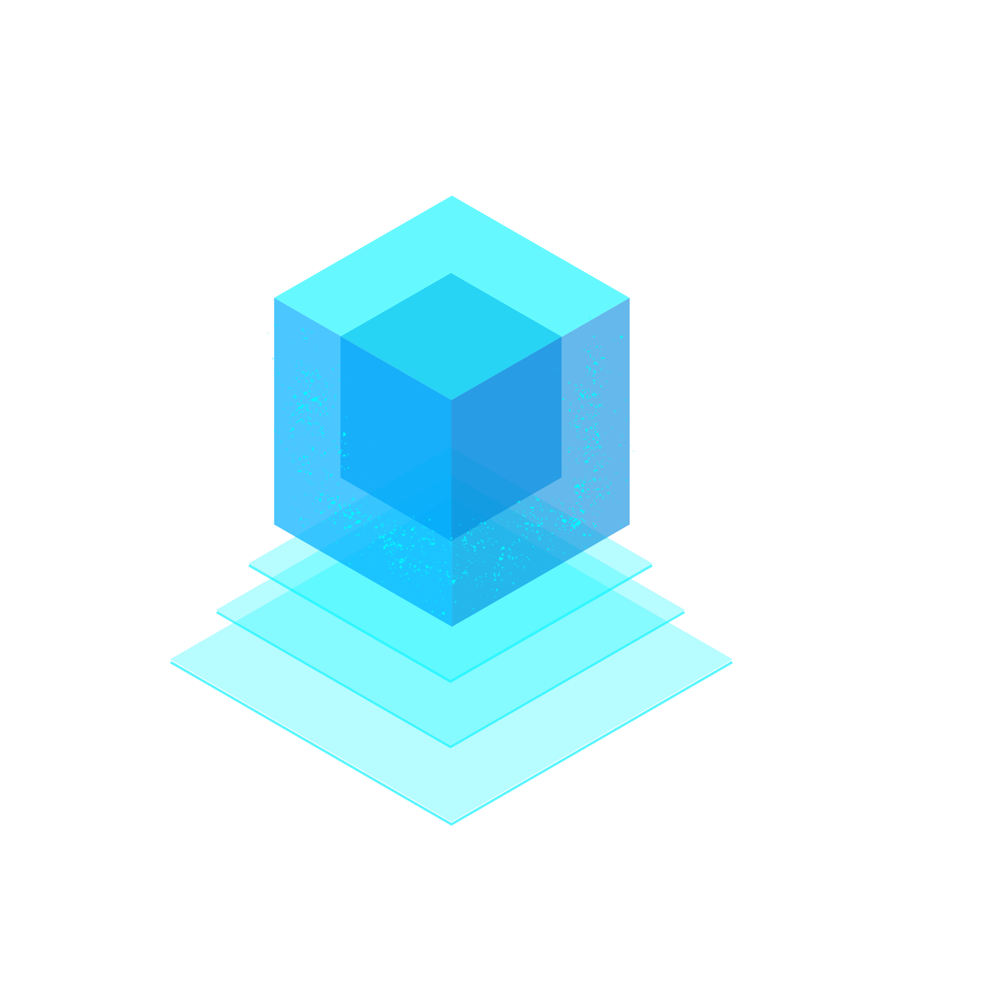
ELECTRONIC HEALTH RECORD USING BLOCKCHAIN

Slide 2
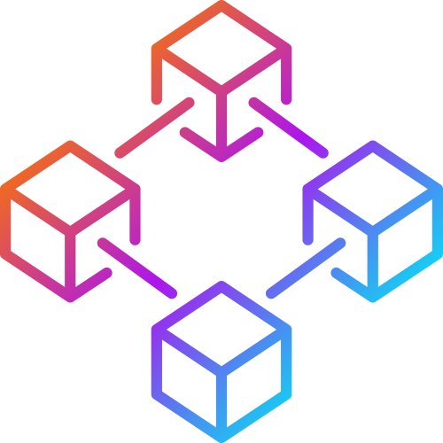
Using Block Chain for Electronic Health Records

Slide 3
INDRODUCTION
1
Let’s start

Slide 4
Blockchain technology is going to revolutionize healthcare and the method in which every patient interacts.

Slide 5
What is Electronic Health Records (EHR)
Electronic Health Record (EHR) is longitudinal electronic record of patient health information
EHR contains all personal health information belonging to an individual; entered and accessed electronically by health care providers.

Slide 6
What is Block Chain ?
Blockchain is a chain of blocks that are connected together and are continuously growing by storing transactions on the blocks.
BlockChain uses a decentralized approach that allows the information to be distributed and that each piece of distributed information or commonly known as data have shared ownership.

Slide 7
What is BlockChain Contd..
BlockChains holds batches of transactions that are hashed thus providing them security and they are managed by peer-to-peer networks.

Slide 8
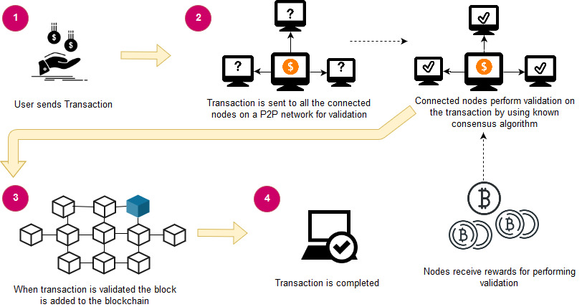
An overview of Blockchain architecture

Slide 9
Why BlockChain For EHR ?
Existing System Problems :
INTEROPERABILITY
The information should be exchangeable and must be usable for further purposes. In EHR systems its Health Information Exchange (HIE) or in general data sharing aspect. With a number of EHR systems being deployed in various hospitals they have a varying level of terminologies, technical and functional capabilities which makes it to have no universally defined standard

Slide 10
Why BlockChain For EHR ? Contd.
INFORMATION ASYMMETRY
The information is centralized to only a single healthcare organization and its control is only provided to the hospitals or organizations .
I.e. If a patient wants to access his medical records he would have to follow a long and tedious process to access them.
DATA BREACHES
Data breaches in healthcare sector also calls for the need of a better platform.

Slide 11
Why BlockChain For EHR Contd.
Proposed System :
DECENTRALIZATION
With blockchain the information is distributed across the network rather than at one central point. It makes the control of information to be distributed and handled by consensus reached upon by shared input from the nodes connected on the network.
DATA TRANSPARENCY
The data or record at stake should be secured and temper proof. Any data being stored on the blockchain is not concentrated at one place and is not controlled by one node but is instead distributed across the network. The ownership of data is now shared and this makes it to be transparent and secure from any third party intervention.

Slide 12
Why BlockChain For EHR Contd.
SECURITY AND PRIVACY
Blockchain technology uses cryptographic functions to provide security to the nodes connected on its network. It uses SHA-256 cryptographic algorithm on the hashes that are stored on the blocks.

Slide 13
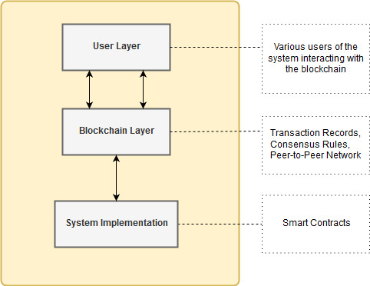
SYSTEM DESIGN AND ARCHITECTURE

Slide 14
System Design
As visible in above figure, the proposed framework or system has three modules. These modules when combined together would keep our system working. These modules have further concepts that need to be understood they are explained as follows.

Slide 15
1 . USER Layer
A user of a system is defined as an individual who makes effective use of the system and its resources. A user has various roles and features on the system, making him identifiable on the system.
The users of this system could be patients, doctors and administrative staff etc. The main task of these users would be to interact with the system and perform basic tasks such as create, read, update and delete the medical records.

Slide 16
User Layer Contd.
The users using this system would be accessing the system’s functionality by a browser, as it is containing the GUI (Graphical User Interface) of the DApp, i.e., our proposed system framework.
The GUI contains all the functions that could be accessed by a particular user. The user according to the assigned role could use this GUI for interacting with the other layer of the system, i.e., blockchain layer.

Slide 17
2 . BLOCKCHAIN LAYER
This layer contains the code or mechanism for interaction of user with the DApp which is functioning on the blockchain. This layer contains three elements inside it. They are:
Blockchain Assets:
In Ethereum blockchain, transaction is the process by which external user can update the state of the record or information stored on the Ethereum blockchain network. These transactions are treated as assets by the Ethereum blockchain as they are piece of information that user can send to another user or to simply store it for using it later.

Slide 18
BLOCKCHAIN LAYER Contd.
Governance Rules:
Ethereum blockchain uses Proof of Work (PoW) consensus algorithm, the reason behind using it is also for ensuring that governance of blockchain is maintained in a trusted manner which is through consent from all the trusted nodes attached to the blockchain network.
Network:
Ethereum blockchain uses the peer-to-peer network. In this network all the nodes are connected as peers. With no node acting as the central node controlling all the functions of the network. The reason behind using this network was because the idea was to create a distributed platform not a centralized.

Slide 19
Transactions
The system includes following transactions
Add records :
would create patient’s medical records in the DApp. It contains the fields of ID, name, co-morbid, blood group, and IPFS hash. The patient’s basic medical records is stored along with the IPFS hash that contains the file uploaded containing the lab results or other medical records of patient

Slide 20
Transactions Contd.
Update records :
would update the medical records of patient. This can only change the basic information of the patient not the IPFS hash. IPFS hash is non-updateable to ensure security of records.
View records :
The view records function is used both by doctors and patients. The patient can view his records by the system authenticating that patient views only his own medical records. For this purpose system uses the public account address of the patient to ensure that only the relevant medical records is shown to the patient.

Slide 21
Transactions Contd.
Delete records :
would make the user be able to delete record of any patient. The user here would be the doctors they are given this right to delete any patient’s record stored on the blockchain.
Grant access :
for each of the above mentioned transactions, certain user would need to have access to them, i.e., only the doctor or nursing staff can make changes in the records of the patient or add them. So, add and update records would only be accessible to these entities. Moreover, patient can view his medical records but won’t be given the access to add or update them.

Slide 22
3 . SYSTEM IMPLEMENTATION
As already explained in the previous sections, the system was implemented by using the Ethereum and its dependencies.

Slide 23
4 . SMART CONTARCT
smart contracts are an important part of DApps as they are used for performing basic operations. Following contracts are included in this framework • Patient Records • Roles
These contracts are used for giving access to the users on the DApp and performing CRUD operations on the records of patient.

Slide 24
SMART CONTARCT Contd.
The Patient Records smart contract is made purely for implementing the functionality of the proposed framework.
Roles is a predefined smart contract by the Open Zeppelin smart contract library. This library contains several smart contracts performing various functionalities that could be used for creating our own functions.

Slide 25
SMART CONTARCT Contd.
This role based access would ensure that no third party is accessing these functions and only the authenticated users of the system would have access to these functions.

Slide 26
ALGORITHM
The Algorithm explains the functioning of the smart contract for patient records. This algorithm has five functions that are to define roles, add, view, update and delete records
Assign Roles :
function Define Roles (New Role, New Account ) add new role and account in roles mapping end function

Slide 27
ALGORITHM Contd.
Add Data :
function Add Patient Record ( contains variables to add data) if ( msg.sender == doctor ) then add data to particular patient’s record else Abort session end if end function

Slide 28
ALGORITHM Contd.
Retrieve Data :
function View Patient Record ( patient id ) if ( msg.sender == doctor || patient) then if ( patient id) == true then retrieve data from specified patient ( id ) return (patient record) to the account that requested the retrieve operation else Abort session end if end if end function

Slide 29
ALGORITHM Contd.
Update Data :
function Update Patient Record ( contains variables to update data) if ( msg.sender == doctor ) then if( id == patient id && name == patient name ) then update data to particular patient’s record return success else return fail end if else Abort session end if end function

Slide 30
ALGORITHM Contd.
Delete Data:
function Delete Patient Record ( patient id ) if (msg.sender == doctor ) then if ( id == patient id ) then delete particular patient’s record return success else return fail end if else Abort session end if end function

Slide 31
Comparison of proposed framework with related work.
 | Existing | Proposed
BlockChainBased | N | Y
Scalabilty | N | Y
Acees Control | Y | Y
Decentralized | N | Y
Interoperability | N | Y

Slide 32
WORKING EXAMPLE FOR PROPOSED FRAMEWORK
The system mainly has two entities, i.e., Administrator and User. Users are further divided into two categories for our proposed framework they are doctor and patient. These users are assigned roles by the administrator of the system who is someone belonging to the hospital’s administrative staff. Here administrator is assigned the task of the defining the granular access to two main users of our system, i.e., doctor and patient .

Slide 33
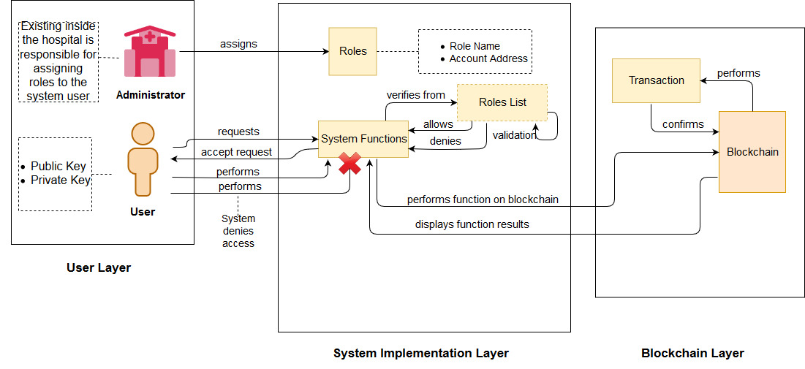
User interaction with DApp

Slide 34

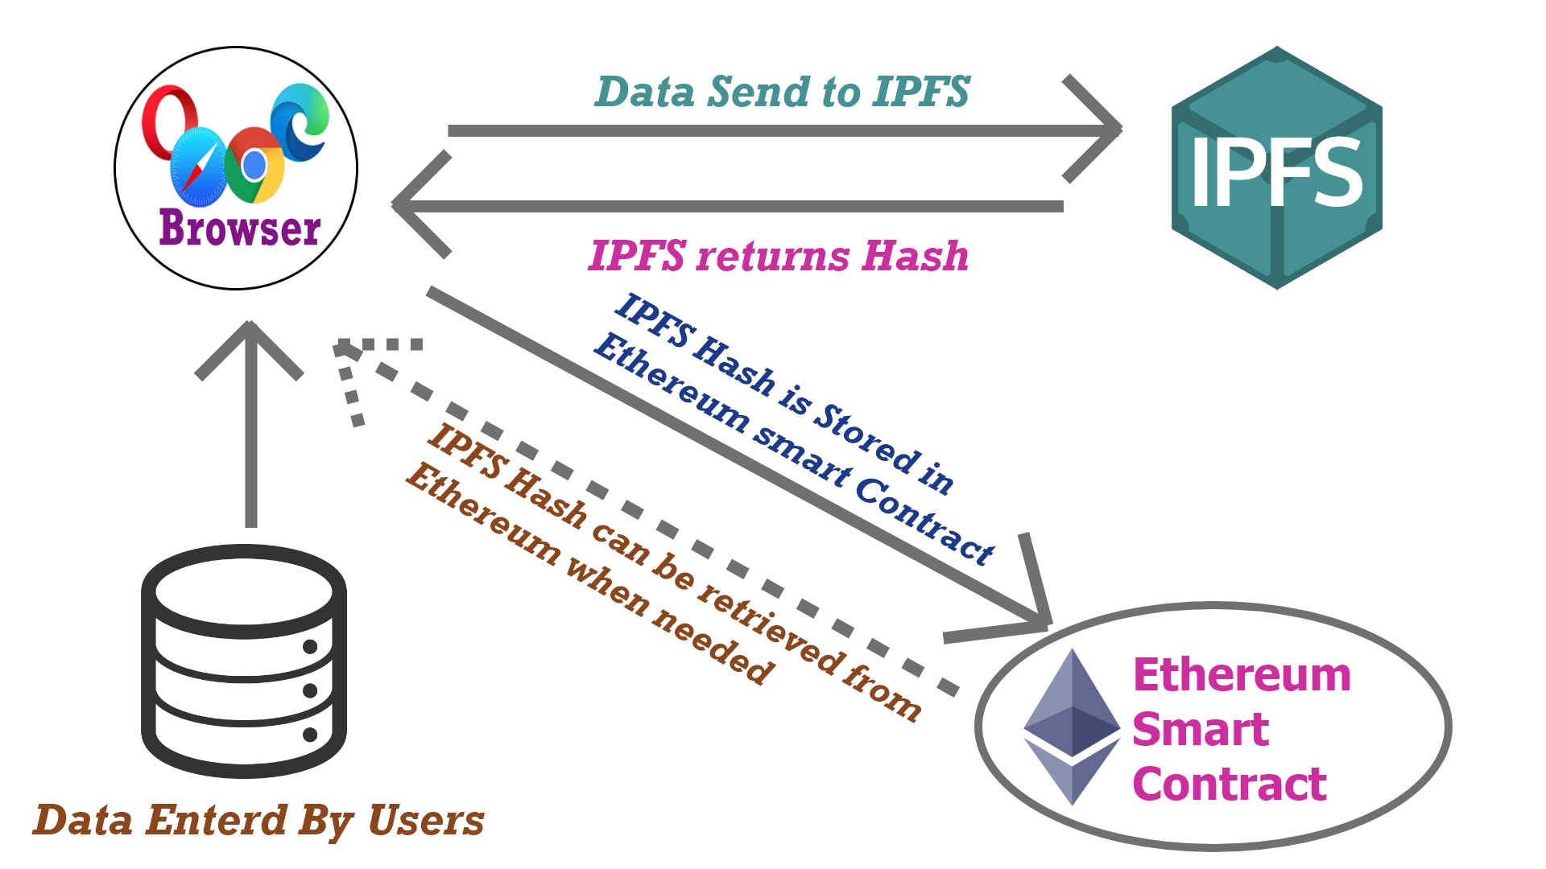
Work Flow of DApp

Slide 35
So, the first activity would be that administrator assigns roles and this would include Role Name and Account Address of the user who is being assigned that role. Every user of this proposed system would have a role name and account address for using the system. So, after administrator assigns this user some role, that role name and account address is stored in a roles list for validation purpose required in later steps.

Slide 36
The Admin function can only be accessed by System Administrator if Any others try to Access the function it throws a Error.!! Message For E.g. :- Doctor try to access Admin Function Figure Given →

Slide 37
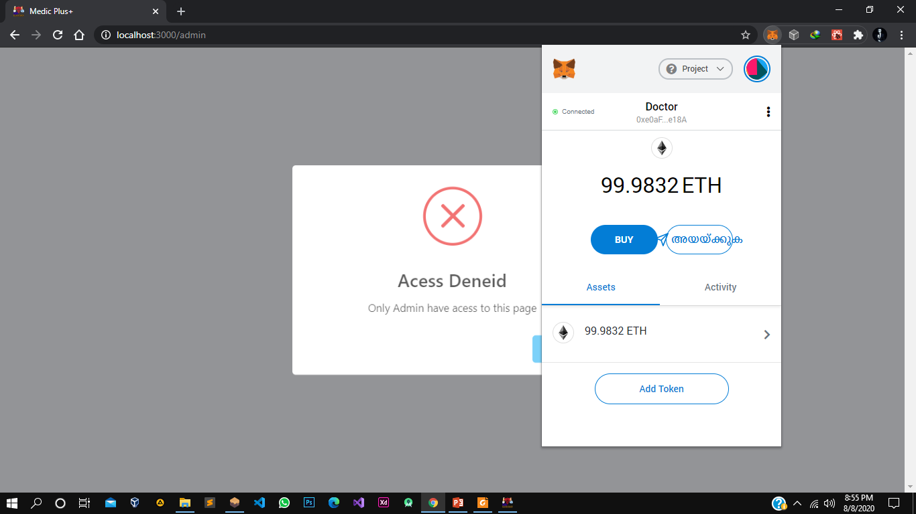

Slide 38
ADMIN MODULE Admin Can:
Add Doctor to the Network
Add Patient to the Network
Delete User(Doctor/Patient)

Slide 39
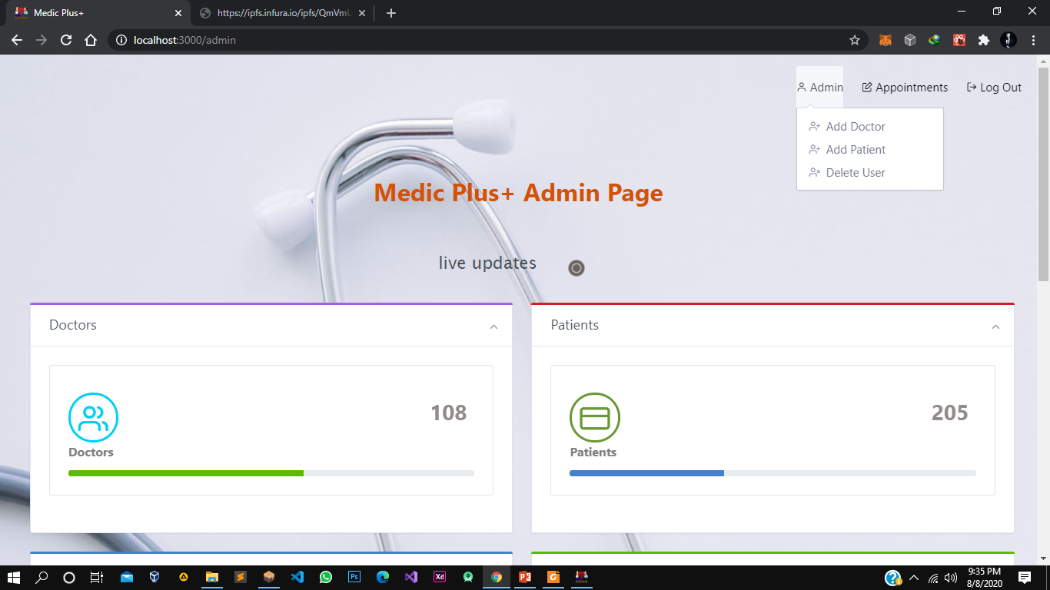

Slide 40
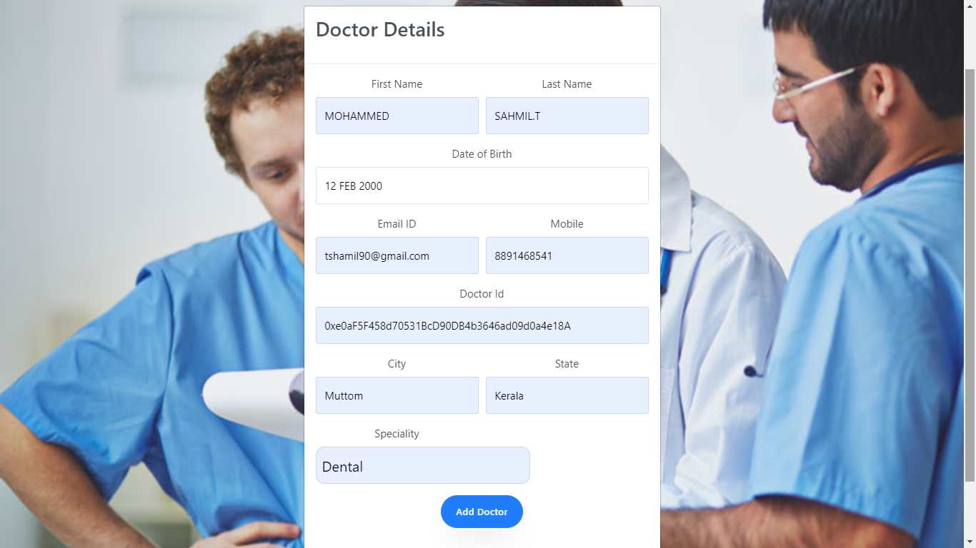
Add Doctor Function

Slide 41
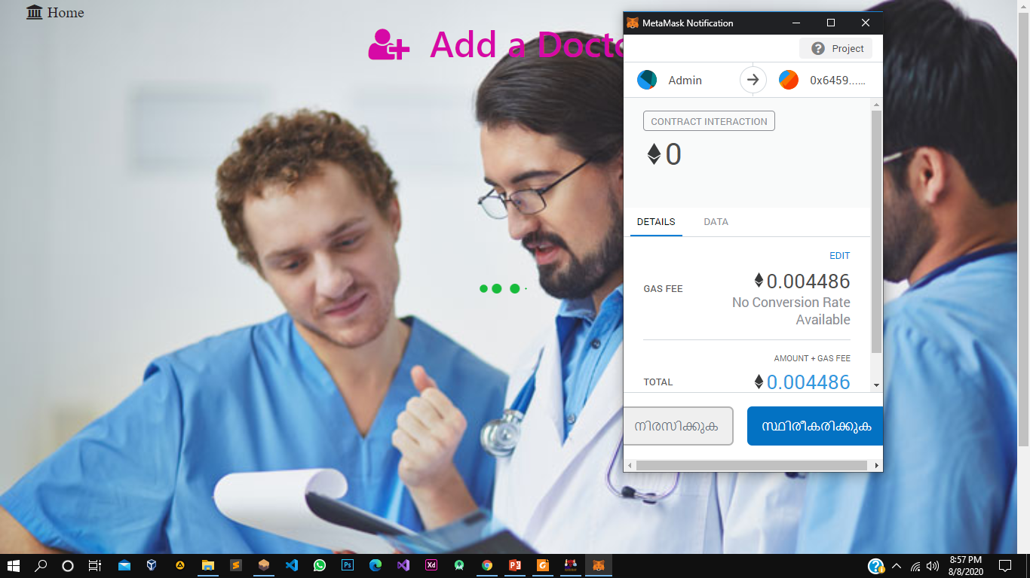
This transaction will cost some Ethers and we need to verify the transaction

Slide 42
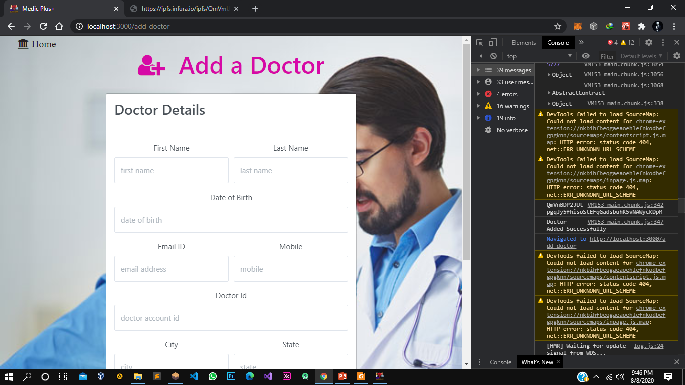
Now this account have access to doctor’s functions. The Doctor Details are Converted to a JSON object and Uploaded to IPFS and IPFS hash is stored in BlockChain

Slide 43
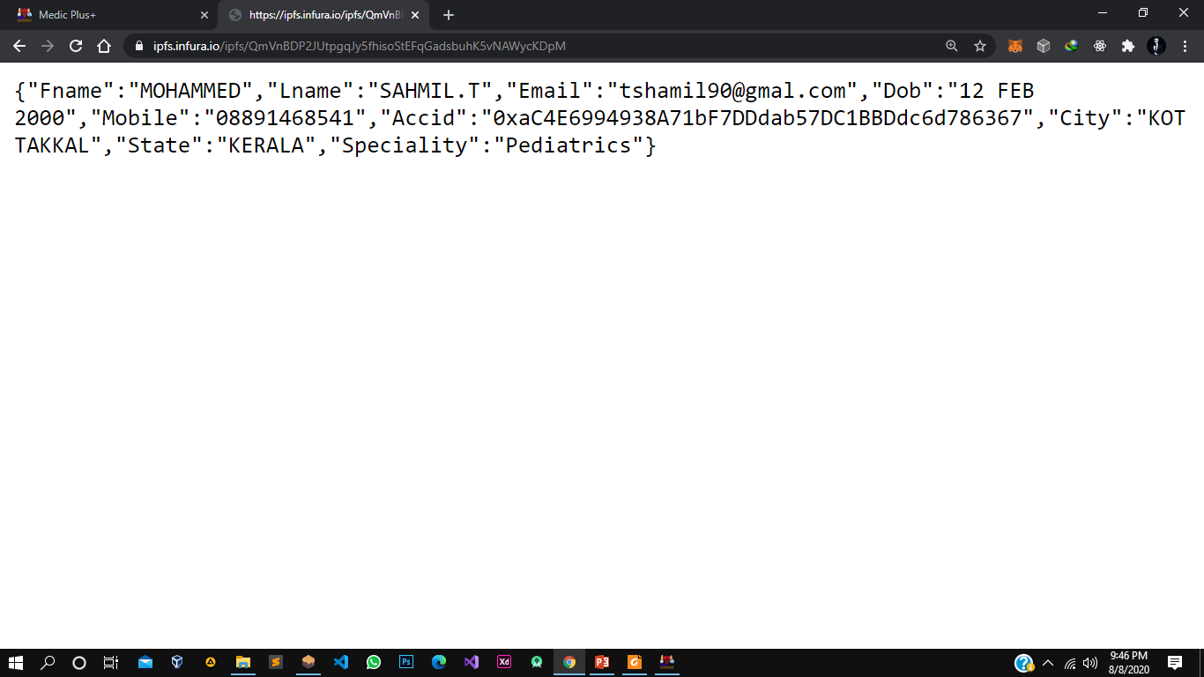
We can retrieve the IPFS Data with the Hash, JSON objects will be returned
The Same way Admin can add Patients

Slide 44
DOCTOR Module
DOCTOR Can :
Add Patient Record
View Patient Record
Update Patient Record
Delete Patient Record
Edit Doctors Info

Slide 45
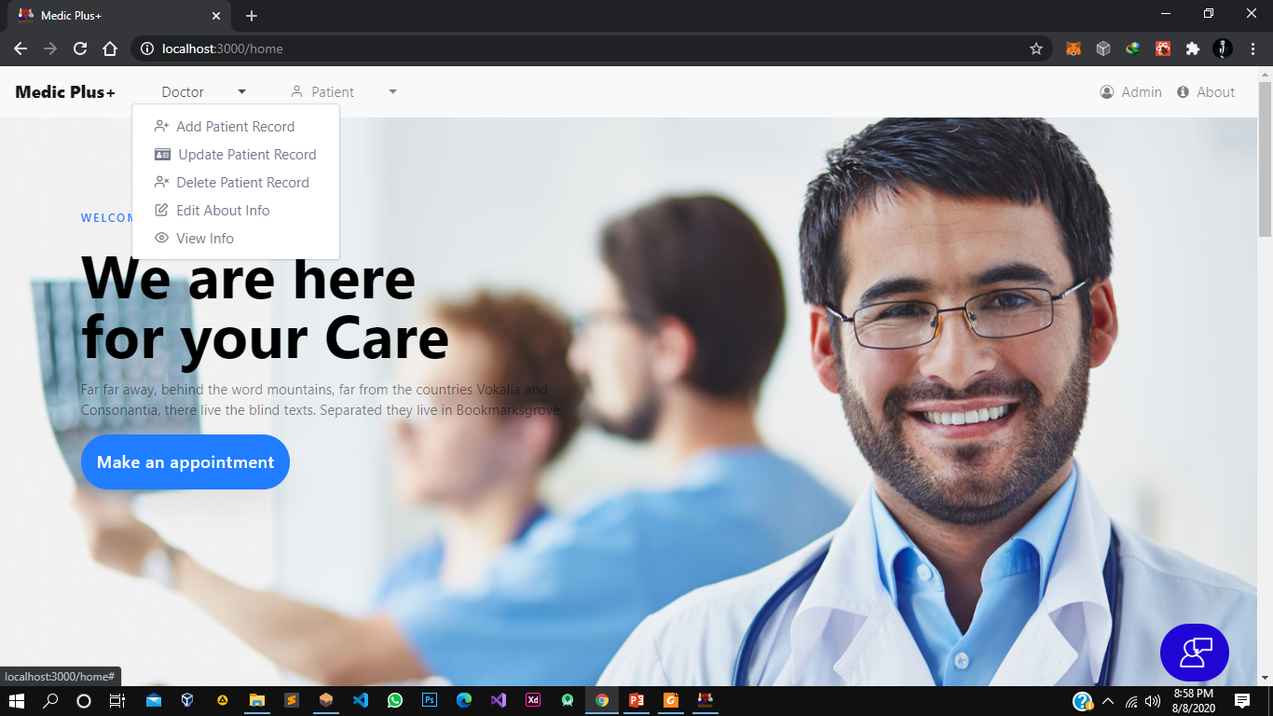

Slide 46
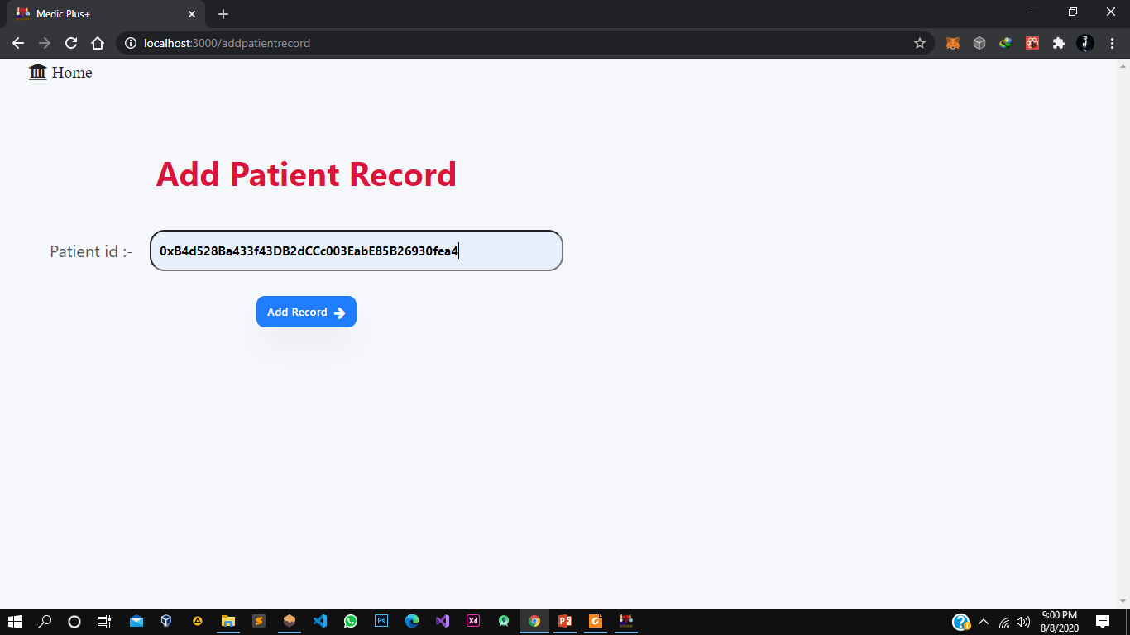
Doctor Can Add Patient Record by Entering the Patents Account ID

Slide 47
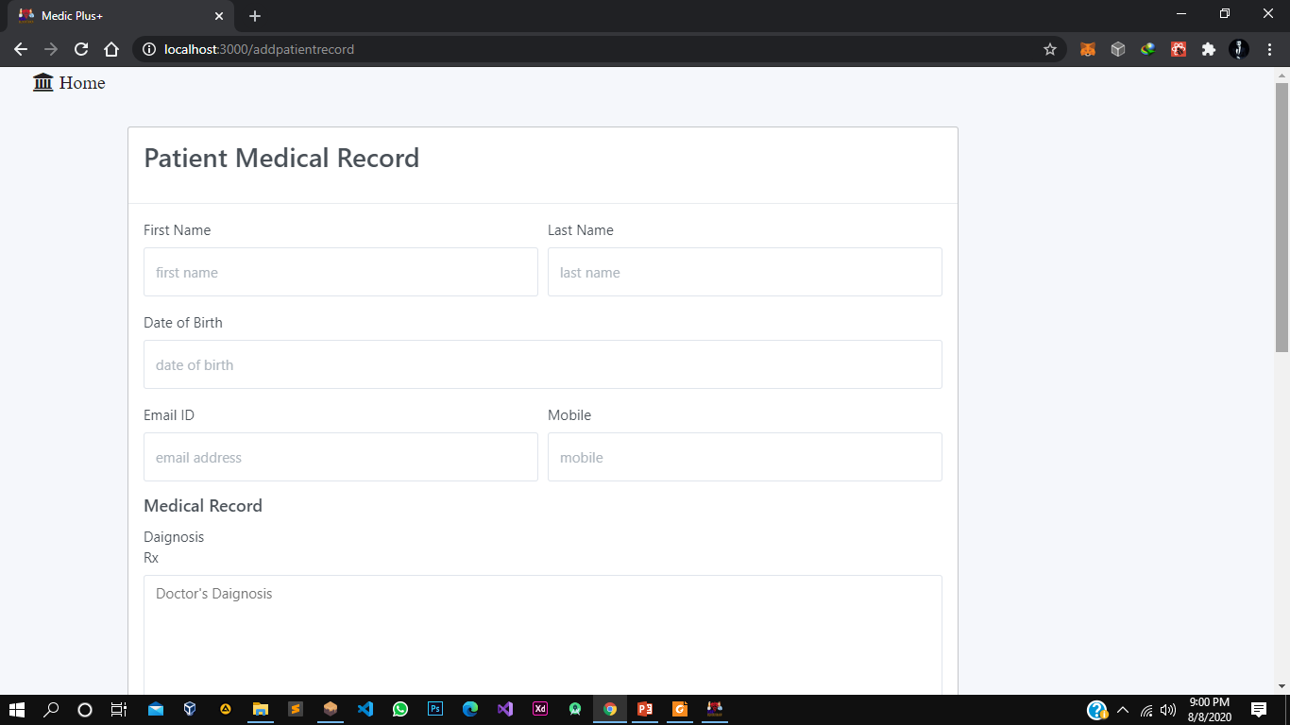

Slide 48
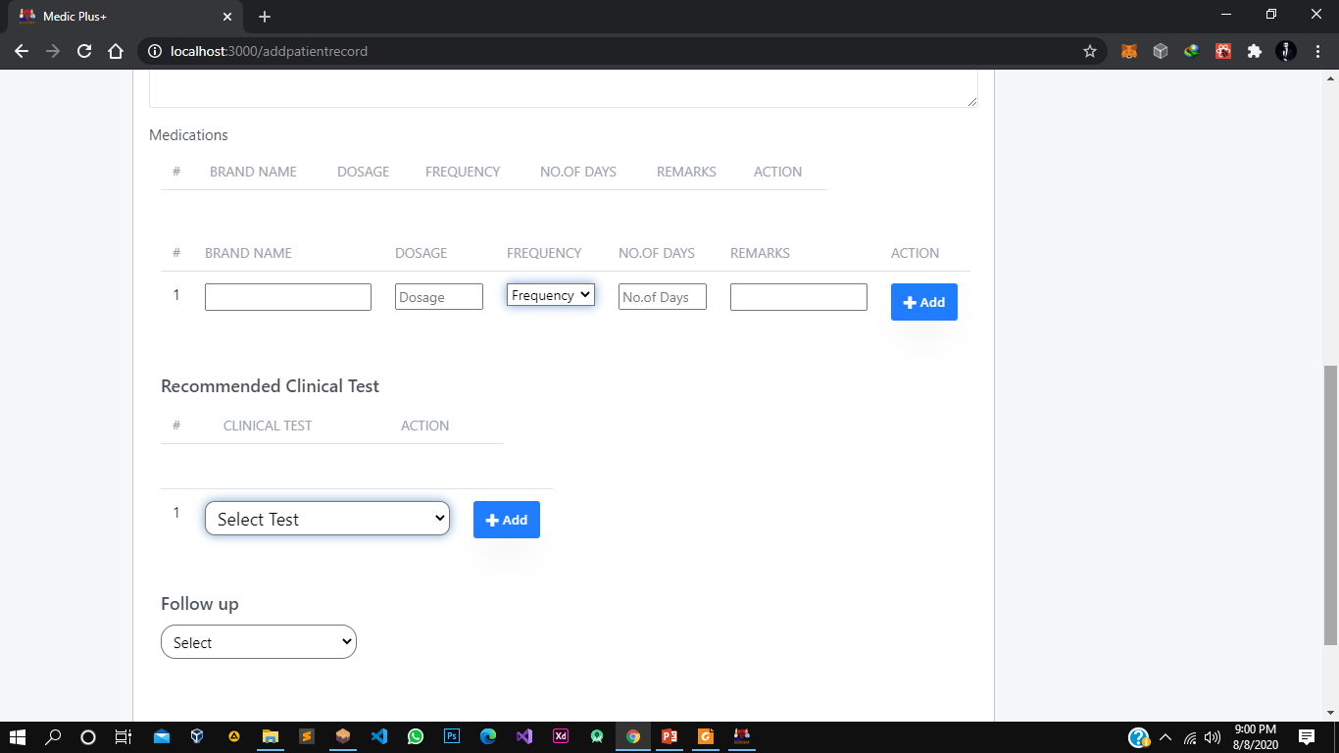

Slide 49
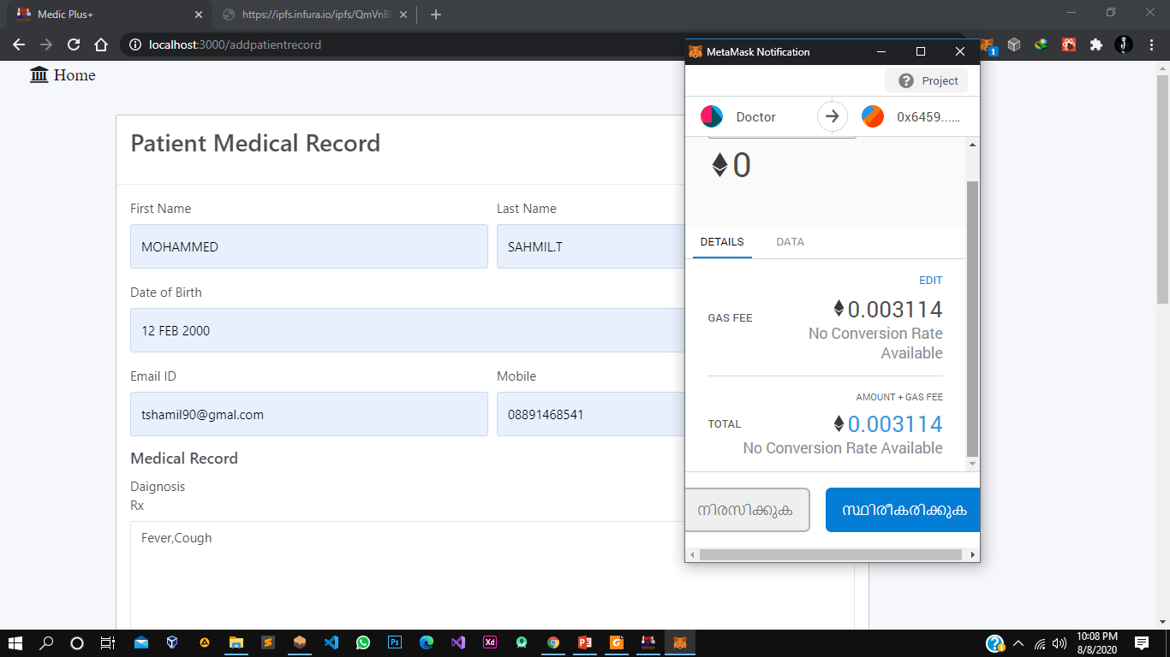
The Adding of data may cost some ethers

Slide 50
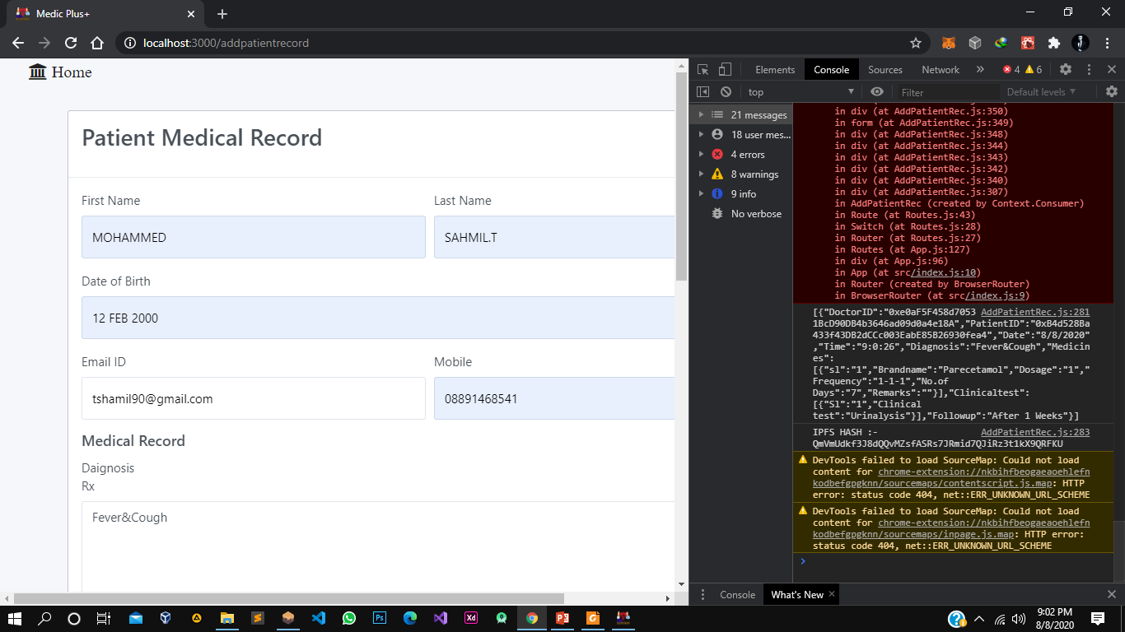
The Patient Medical Record are converted to JSON object and Send to IPFS and IPFS return The Hash which then we can store in Blockchain, and we can use it to retrieve the record

Slide 51
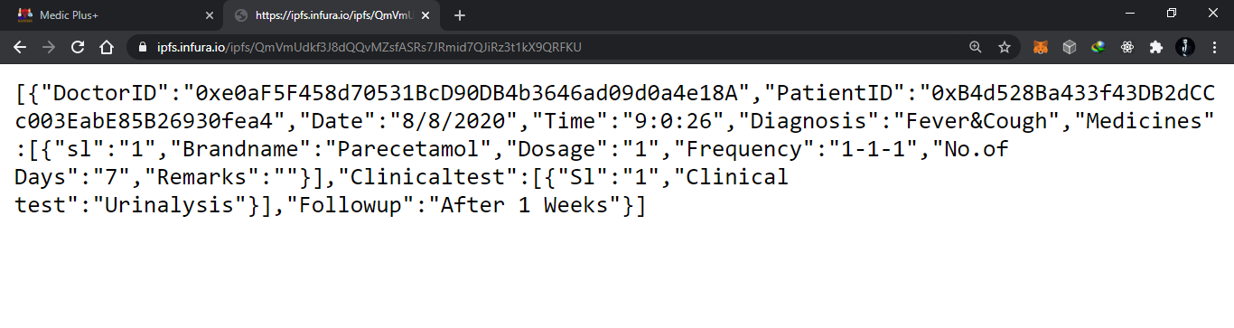

Slide 52
PATIENT MODULE
PATIENT CAN :
View medical info
Edit About info

Slide 53
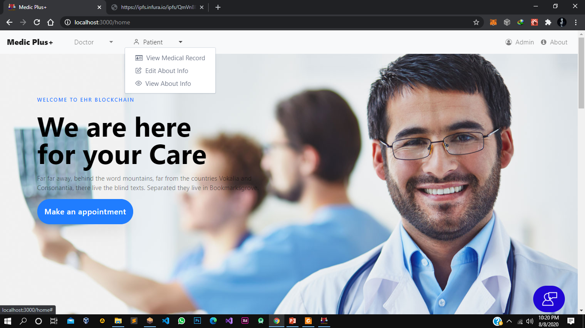

Slide 54
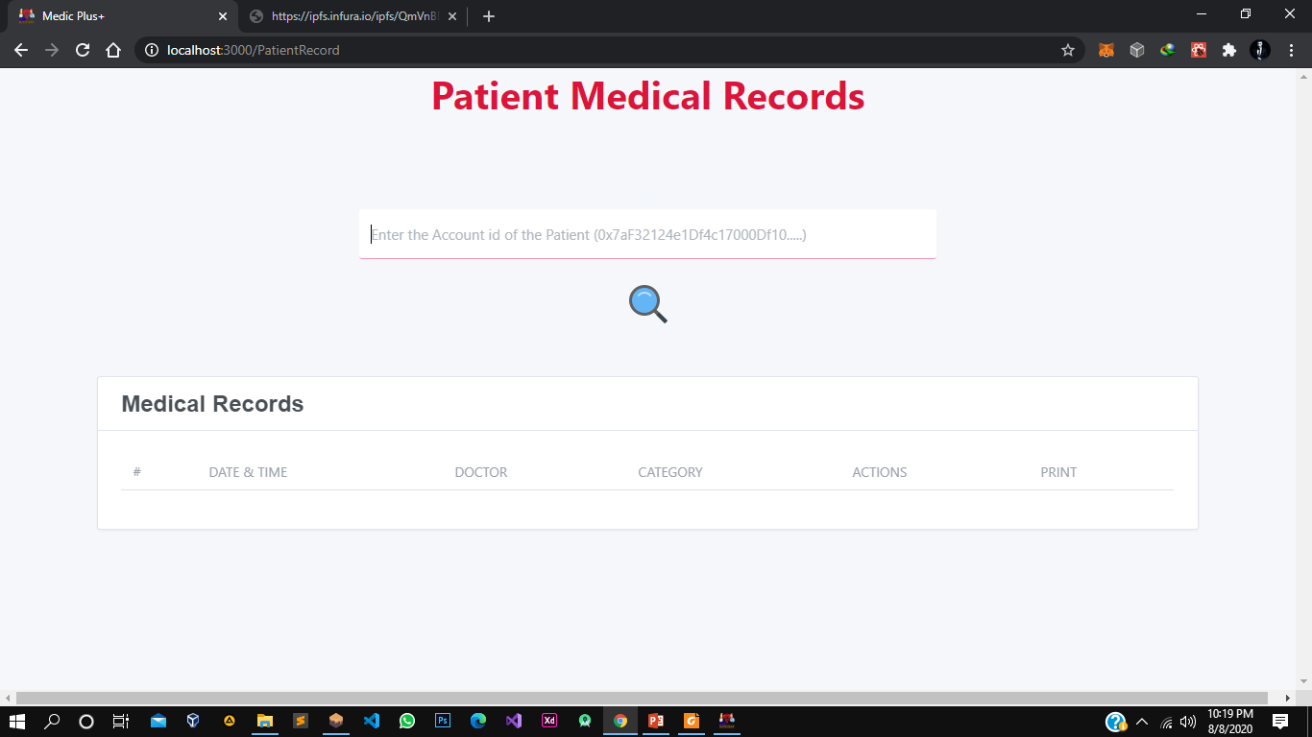
Records are arranged by date, Patient cannot edit the records

Slide 55
Development Environment
Front End :
ReactJS, HTML, CSS,JS
Back End :
NodeJS, Ganache(BlockChain), Truffle Framework,
Metamask Browser extension (Connect Browser to Blockchain),
Some NodeJS Libraries.
IDE :
VSCode

Slide 56
Conclusion & Future Works
In this project we discussed how blockchain technology can be useful for healthcare sector and how can it be used for electronic health records. Despite the advancement in healthcare sector and technological innovation in EHR systems they still faced some issues that were addressed by this novel technology, i.e., blockchain. Our proposed framework is a combination of secure record storage along with the granular access rules for those records. It creates such a system that is easier for the users to use and understand. Also, the framework proposes measures to ensure the system tackles the problem of data storage as it utilizes the off-chain storage mechanism of IPFS. And the role-based access also benefits the system as the medical records are only available to the trusted and related individuals. This also solves the problem of information asymmetry of EHR system.

Slide 57
Conclusion & Future Works Contd.
Feature Works :-
we plan to implement the payment module in the existing framework. For this we need to have certain considerations as we need to decide how much a patient would pay for consultation by the doctor on this decentralized system functioning on the blockchain. We would also need to implement medical insurance module for patients and also a Appointment module , there the patients can take appointments to see the doctors.

Slide 58
THANKS!

